Slide 1
Movie Recommendation:
A Hybrid Content-Based/ Collaborative Filtering Approach
Eric Corbu
Yousef Fahim
Arhan Ikram
Yurong Jia
Benson Leung
Abhijit Singh
Notes:
Eric

Slide 2
What questions are being addressed?
Given a user’s movie ratings, and other user ratings, what movies might they like?
FInd other users with similar preferences by analyzing all movie ratings across all users.
What movies are similar to the movies they like?
Use movie metadata and apply natural language processing to find similarity between all movies
Then, find movies similar to user’s most recently watched movie.
How close can we get to predicting a user rating?
This is how we will measure the accuracy of our predictions. The RMSE between the predicted rating and the real rating gives use the accuracy.
Notes:
Eric
We want to build a movie recommendation system. What do we want to learn?
Based on a matrix of ratings from different users, can we estimate which movies a particular user will like?
Another question we have is
Can we find similar movies to a movie they enjoyed?
Using the provided and external metadata, we will apply natural language processing to find similarity between all movies
Then, using that similarity matrix we will find movies similar to their most recently watched movie?
Using these techniques, how close can we get to predicting a user rating?
How closely we can predict a rating is how we determine the accuracy of our recommender system. The Root Mean Squared Error tells us the difference between the predicted, and real user rating.

Slide 3
Retrieve:
[genres, ratings, movieId, userId] from dataset, [director, plot] from IMDb
Using TF-IDF, and string of genres + plot + director, build similarity matrix between all movies
Use content-based method to filter potential recommendations, then collaborative filtering to get the highest rated recommendations.
Feature Extraction
Data Preprocessing
Content-based Approach
Collaborative Filtering
Combine results
Genres data converted to format that can be handled by TF-IDF. Director data and plot are appended.
Using SVD matrix factorization algorithm, find other users with similar preferences, and retrieve suggestions based on their rating history.
Notes:
Eric
Feature extraction: gather all relevant data
We have multiple files and we want to combine the data into a usable format.
Preprocessing: converting the data to a format that can be handled by TF-IDF vectorizer
Content-based: use ‘mega-meta’ column to build similarity matrix using TF-IDF
Collaborative Filtering: on the user-rating matrix apply the SVD matrix factorization algorithm to estimate ratings for unseen movies
Use content-based method to filter to 35 movies based on users last watched movie, then find the movie with the highest estimated rating

Slide 4
Solution/Method
Notes:
Eric

Slide 5
Content Based Recommender
What we use
From each movie
Genre
Director
Plot Summary
From the user
Previous preferred movie data
What we want to determine
Similarity is calculated from the item’s feature vectors, this personalizes our recommendations more, as it computes similarity between movies based on certain metrics and suggests movies that are most similar to a particular movie that a user liked.
Then, we use the top 35 most similar movies to filter which ones we want to apply collaborative filtering, this process is called Content Based Filtering
Notes:
Eric
To determine similarity between movies, we first need to decide what features we will use.
We will use genre from the provided dataset, and director and plot summary from the imdb data for that movie which we extracted separately.
We also use the user’s most recent preferred movie to determine what similar movies we are looking for.
By combining these features, [genre, director, plot] we can use TF-IDF to find the most similar movies.
We then pass only top 35 most similar movies to the matrix factorization method, in a process called content based filtering.

Slide 6


Content Based Recommendation- Technique and Tools
Pull data from IMDb website for feature enrichment and meta collection
Combine all metadata into one string
genres: [“Comedy”, “Drama”]
director: “Martin Scorsese”
plot: “This exciting movie…”
becomes-> “Comedy Drama martinscorsese This exciting movie…”
By combining all metadata into one string, we can still compute a prediction with a missing value.
Use TF-IDF Vectorizer from scikit-learn package
Compute pairwise cosine similarity based on TF-IDF matrix between movies
Sort by cosine similarity score to produce list of most similar movies
Notes:
Eric
First we extract all of our data from the external sources we need.
Then, we combine the 3 features (genres, director, comedy) into one column
Third, we apply TF-IDF Vectorizer from scikit-learn to this combined column
For each entry, we compute the pairwise cosine similarity.
Then if we access the index of a particular movie, we can sort that row based on cosine similarity score to produce a list of the most similar movies.

Slide 7
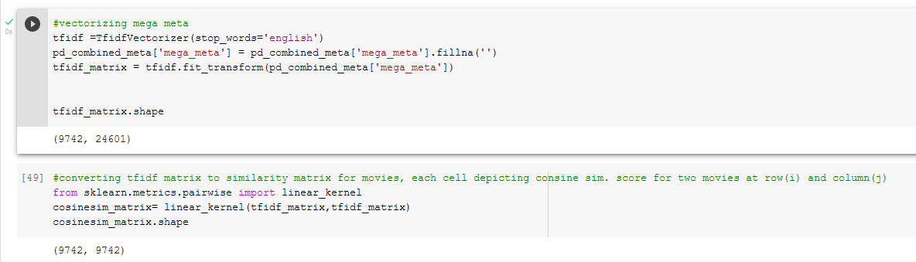
Using TF-IDF
Notes:
Eric
Here is the implementation of the TF-IDF processing
We set the TFIDFVectorizer to use english stop words, which ignores words which do not contain relevant information such as “a or and”.
Then we replace any null values with an empty string.
After applying the vectorizer suing fit_transform(), We get a matrix with 24601 columns which represent unique terms, across 9742 movies.
Once we compute the pairwise cosine similarity using linear_kernel from sklearn.metrics.pairwise, we get a square matrix.
Each diagonal in the matrix has a value of 1, and every other value represents the similarity between two different movies.

Slide 8
Traditional Collaborative Filtering
User-Based
Measures similarity between target users and other users
Downsides:
User preferences can change over time.
Bad performance because matrix is precomputed based on neighboring users
Item-Based:
Measures similarity between items target user liked and other items
Downsides:
Scalability, as computation complexity is O(mn) where m is users and n is items
Sparsity can cause inaccurate recommendation.
Notes:
-Although computing user-based CF is very simple, it suffers from several problems. One main issue is that users’ preference can change over time. It indicates that precomputing the matrix based on their neighboring users may lead to bad performance. To tackle this problem, we can apply item-based CF.
-However, several problems remain for this method. First, the main issue is scalability. The computation grows with both the customer and the product. The worst case complexity is O(mn) with m users and n items.In addition, sparsity is another concern.In extreme cases, we can have millions of users and the similarity between two fairly different movies could be very high simply because they have similar rank for the only user who ranked them both.

Slide 9
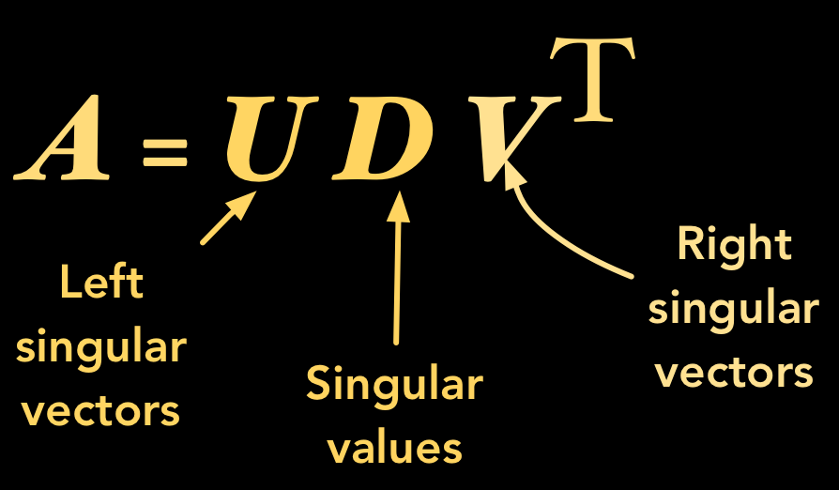

Collaborative Filtering - Tools and Techniques
Deepcopy user-rating matrix
Apply Singular Value Decomposition (SVD) Algorithm to copied rating matrix
SVD fills empty rating cells with estimated rating
Sort recommendations based on row value
Notes:
-One way to handle the scalability and sparsity issue created by CF is to leverage a latent factor model to capture the similarity between users and items. Essentially, we want to turn the recommendation problem into an optimization problem.
-To give a general idea, describes a property or concept that a user or an item have. For instance, for music, latent factor can refer to the genre that the music belongs to. SVD decreases the dimension of the utility matrix by extracting its latent factors. Essentially, we map each user and each item into a latent space with dimension r. Therefore, it helps us better understand the relationship between users and items as they become directly comparable.

Slide 10
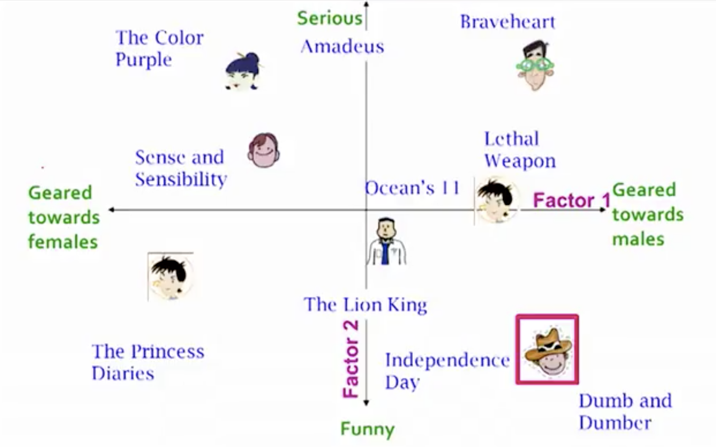
Why Singular Value Decomposition (SVD)?
Singular Value Decomposition
Recommendation problem -> optimization problem
SVD is designed to minimize lowest Sum of Square Error (SSE), which in turn minimizes Root Mean Squared Error (RMSE), which means it improves the accuracy of the recommendation.
Notes:
SVD handles the problem of scalability and sparsity posed by CF successfully. However, SVD is not without flaw. The main drawback of SVD is that there is no to little explanation to the reason that we recommend an item to an user.

Slide 11
A Hybrid Approach
Content-based
Based on item representation, making it independent of the user
Resolves the new product cold start problem.
Negative:
Lacks personal taste
Inability to suggest items outside similarity metrics
Collaborative filtering
Doesn't need contextual features (inexpensive in our case)
Can help users discover new interests.
Negative:
Preferences of other users might not match user preferences closely enough.
Subject to user cold start problem

Slide 12
Comparison
vs Content Based only
Our model gives a more personalised result than content based alone.
Able to make recommendations outside similarity metrics, helps user to develop new taste
vs Collaborative Filtering only
Avoids cold start problems by making use of Content based filtering
Avoids scalability issue by making use of latent factor model

Slide 13
Data Overview
movieId
Unique identifier for each movie. Some ids in the range are missing, not reliable for indexing, e.g. 33 is missing but 32 and 34 exist.
Genres
19 Genres, plus one extra ‘no genres listed’ for the movies which aren’t attributed to a genre.
Tags
Tags are user generated descriptors. Can be actor name, thoughts on the movie, single words or full sentences.
Ratings
Ratings are the most important factor in determining the user preference. Without rating, we don’t know for sure if the user liked the movie or not.
Genres, plot, director content-based model
Ratings collaborative filtering model
Notes:
From the movie database given, the first feature we are interested in is movieID, which is a unique identifier for each movie. Some IDs in the range are missing, which presents a problem for indexing. For example movieID 33 is missing but 32 and 34 exist. The second feature we are interested in is genres. There are 19 unique genres in the database, plus one extra “no genres listed” for the movies which aren’t attributed to a genre. Each movie can have multiple genres which can help fine tune and match movies. Another feature is tags, they are user generated descriptors that can be anything a user would think of to put in such as an actor’s name, thoughts on the movie, and they can come in single words or full sentences. Lastly, we have the Ratings which are the most important factor because it determines the user’s preference. The whole system is for finding a movie the user will like and without ratings we wouldn’t know if the user will like it or not. At the bottom we see genres, plot, and director help the content-based model, and ratings help the collaborative filtering model. We will get to plot and director shortly.

Slide 14
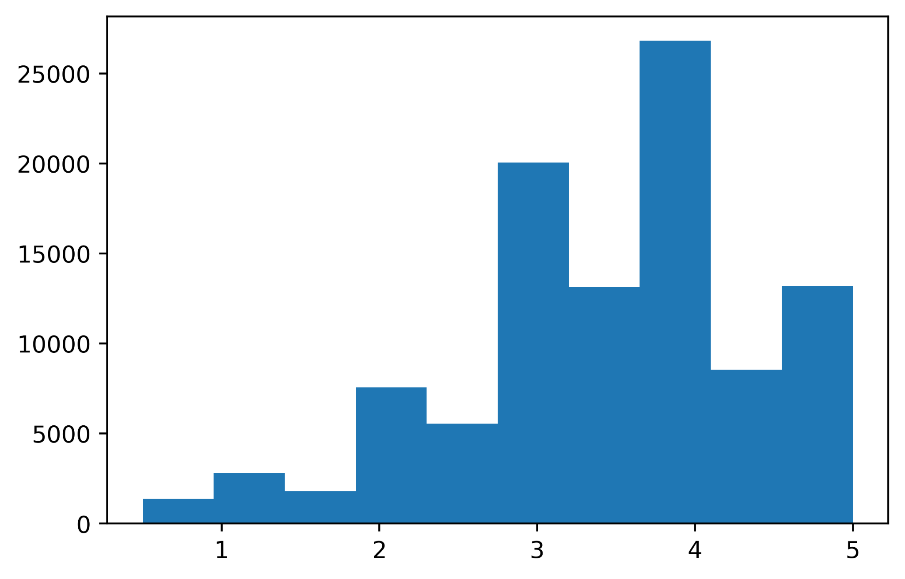
Ratings, a Look at the Data
Mean
~3.50156
Median
3.5
Mode
4.0 given 26818 times
Left Skewed
~60% of ratings 3 <= rating <= 4
Lack of Data
~50% of the movies have only one or two ratings
Notes:
So for a simple look at the ratings data, we have a mean of ~3.5 and a median of 3.5. The mode of 4.0 was given over 26k times. Even though the mean and median are about the same, the data has a left skew on it because ~60% of the ratings are between 3 and 4. This makes sense because people would watch movies they are interested in seeing, and generally don’t watch something they might dislike in the end. There was also a lack of data present, around 50% of the movies have only one or two ratings. This doesn’t really present a good sample for how a general public would enjoy the movie.

Slide 15
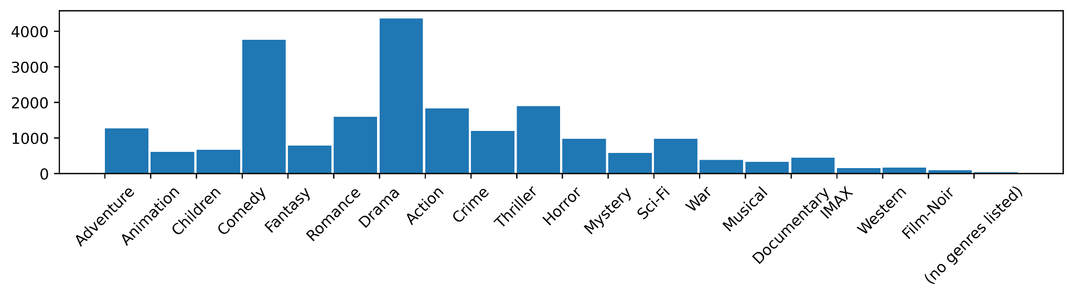
Genres, a Look at the Data
Most Frequent
Drama, Comedy, Thriller, Action, Romance
Empty Values
34 titles have ‘no genres listed’
Least Frequent
Film-noir, IMAX, Western, War
Notes:
So for genres, we have 19 categories and a movie can have several genres if necessary. We see that the most frequent are drama, comedy, thriller, action, and romance. This is expected as the first movie to pop in your mind would most likely fit at least one of these categories. Least frequent are film-noir, IMAX, western, and war. IMAX is an entire system that needs specialty equipment and the rest are genres that by themselves are not that popular so this isn’t a big surprise either. 34 titles had “no genres listed”. We relied on the other features in this case.

Slide 16
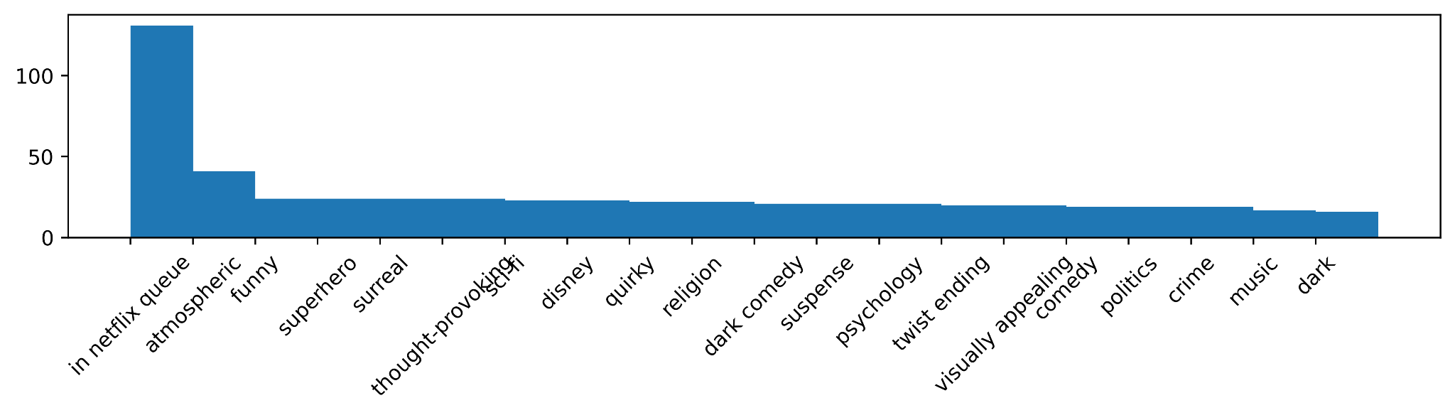
Tags, a Look at the Data
Descriptors
‘Atmospheric’, ‘funny’, ‘surreal’, ‘quirky’
More Specific Genres
Action -> superhero, comedy -> dark comedy
Length
Can be long like 'something for everyone in this one... saw it without and plan on seeing it with kids!' or short like 'tv', 'dc', 'rug', 'wry', 'fun'
Notes:
For tags we can see that the most common one was “in netflix queue” which is not a great start. They can be descriptors that can help describe the feeling of a movie more in detail. Such as “atmospheric” or “surreal”. They can also be used to be more specific and aid genres, such as an action movie can be fine tuned to a superhero action movie and a comedy can be fine tuned to a dark comedy movie. Now these are short one or two word tags, however the length of the tag can vary. It can be long as something like quote “something for everyone in this one.. Saw it without and plan on seeing it with kids!” that may help a user manually reading tags, but this is extremely subjective and could hurt the model more than it can help it.

Slide 17
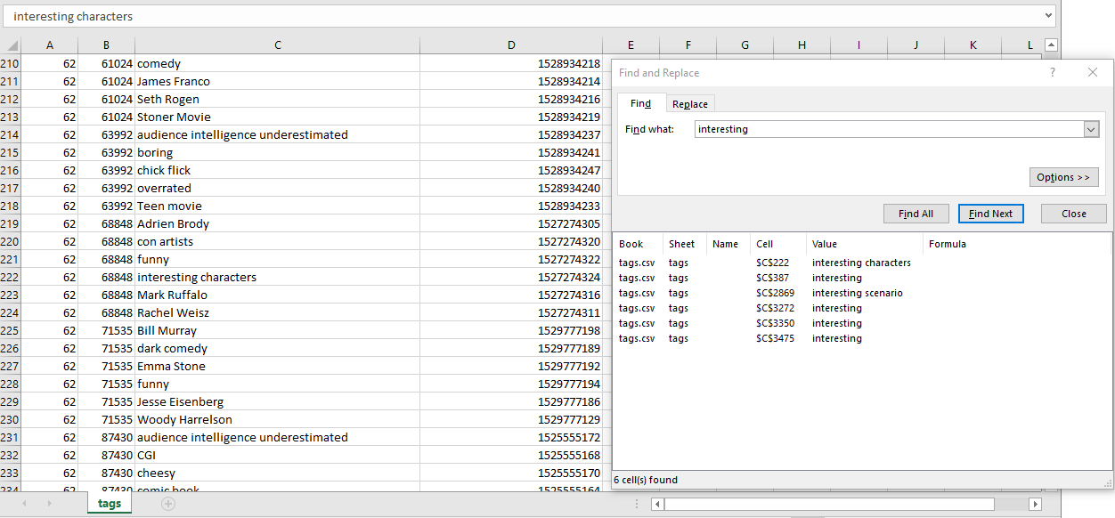
Tags, A closer look
Tags aren’t great
Tags are very subjective based on user. Some user might say ‘interesting’, another user might say ‘boring’
Too Subjective
For a content based approach, we want to eliminate user biases. ‘Funny’, ‘interesting’ will not give us an accurate description of the content.
Notes:
So having that, we believe that tags aren’t great. Tags are very subjective based on the user. Some user might say a movie is “interesting”, but another user might say it’s “boring”. For the content based approach, we want to eliminate user biases. “Funny” or “interesting” will not give us an accurate description of the content. And as you might be able to see in the picture there, a search through the tags data set with the keyword “interesting” only has 6 results, there is no way that there are only at most 6 movies in the entire data set that are interesting so it isn’t a good measure. And now Abhi with more information about how to make the data better.

Slide 18
How can we do better?
Tags are Too Subjective
For a content based approach, we want to eliminate user biases. ‘Funny’, ‘interesting’ will not give us an accurate description of the content.
External Data Sources
Links.csv contains imdbId and tmdbId, to facilitate gathering external data.
Using IMDb, we can extract plot summary and director data from IMDb using IMDbPY package.
Notes:
We found the tag information a little inconsistent for our use, which was eventually resulting in poor suggestions. We wanted to have as much contextual information for different movies as possible which would eventually be used in the content recommendation part of the project. We made use various python libraries and data provided to us to scrape the internet for more data on each movie. This provides better matching descriptive features

Slide 19
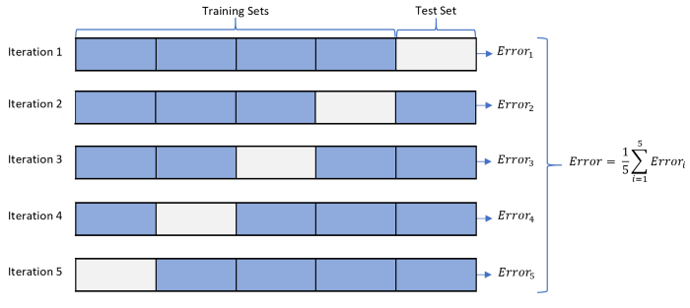
Data Preprocessing
Using NLP techniques for better contextual features
Preprocessing given data
Problems with presented data(experimentation)
Leveraging given data using IMDb website through parallel processing
Created different samples of data using multi-folds creating multiple random test and train splits of 20% and 80% respectively.
Notes:
We used various techniques to make data more relevant to the problem at hand:
1)Making use of NLP techniques such TFIDF vectorization as discussed on the next slide
2) The genres of the movie were provided in list format which were incompatible with the TFIDF vectroization method. We converted the that data to string format for inclusion into the final meta-data dataframe.
3) As discussed earlier, Tag information did not provide the best results, so we
4)Including information about the directors and movie plots provided us with huge performance boost. This is because movies sharing similar plots tend to be similar in general. Movies by same directors are usually preferred by user if they like some particular niche movies.
5)For training our data for SVD part of the project, we wanted to test and train data on different parts of the data to avoid problems like over fitting and underfitting. We did this by creating splits of testing and training data and went through with 5 fold approach.

Slide 20
Data Preprocessing
External Data Format
Genres: list of strings - [“Comedy”, “Drama”]
Director: string - “Michael Bay”
Plot: string - “A deadly threat from Earth's history reappears and a hunt for a lost artifact takes place between Autobots and Decepticons, while Optimus Prime encounters his creator in space.”
How do we fit external data to TF-IDF model?
Convert genres to String: [“Comedy”, “Drama”] -> “Comedy Drama”
Must process director name, as “Michael” could match with other directors with similar first name but “michaelbay” tells us precisely who the director is.
Combine Features
[“Comedy”, “Drama”], “Michael Bay”, “A deadly threat from Earth's history reappears and a hunt for a lost artifact takes place between Autobots and Decepticons, while Optimus Prime encounters his creator in space.”
Becomes
Comedy Drama michaelbay A deadly threat from Earth's history reappears and a hunt for a lost artifact takes place between Autobots and Decepticons, while Optimus Prime encounters his creator in space. This is what we use in the TF-IDF model.

Slide 21
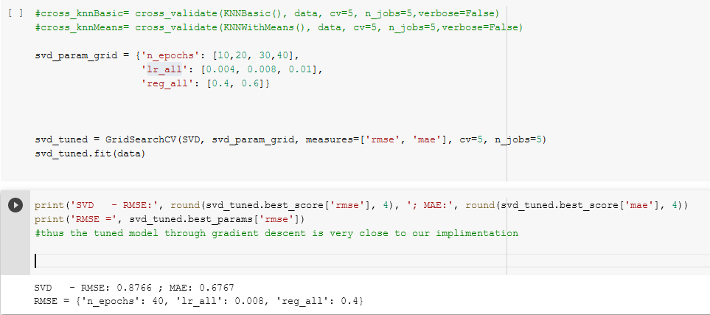
Experimentation
Experimentation:
1)Passing right number of movies from content based to hybrid algorithm. Lacks direction when passed the entire row of similarity matrix
2)Fine tuning hyperparameters for SVD using GridSearchCV provided variety of different parameter sets such as n_epochs, the learning rate for all parameters and the regularization term for all parameters. Only best param are chosen for fine tuning
3)Manual user based testing
Notes:
For experimentation we wanted to make sure our approach gave us the desirable results:
-We experiment with the number of movies that were being passed from the content based system to the hybrid part. More the number of movies lead to worse predictions, this is due to SVD scoring all the movies and the movies that have high score due to being rated by very few user similarly make it to the top. Similarly too little movies lead to worse performance
-Manual hypertuning was not yielding right results, so we used gridserachcv by sklearn library.
-We also tuned our model based on manual user testing, this was using friends, family and taking their feedback to fix details

Slide 22
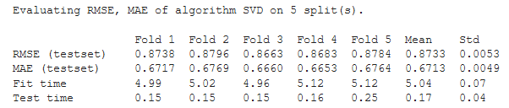
Evaluation
Evaluation is performed using Root Mean Squared Error (RMSE) and MAE (Mean absolute error)
The lower the RMSE, the better our model performs.
Since SVD treats MF as an optimization problem for minimizing, SSE(Error Sum of Squares) which in turns minimizes the RMSE for better prediction results.
Notes:
The following are the evaluation results for different iterations using different sets of training and testing data.
When compared against different baseline algorithms the we achieve the following results:

Slide 23
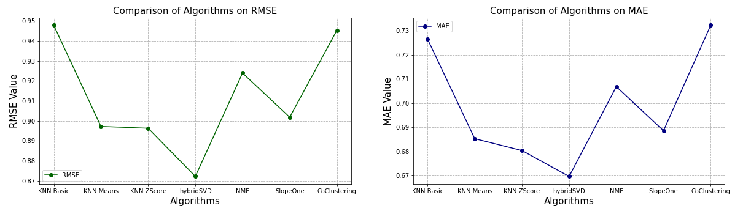
Comparison to different baselines

Slide 24
Results, Does our conclusion match?
The questions we sought out to answer are:
Given a user’s movie ratings, and other user ratings, what movies might they like?
Using SVD matrix factorization model, we were able to compute predicted ratings with reasonable accuracy.
What movies are similar to the movies they like?
By extracting genres, and gathering external data such as director and movie we were able to find similar movies based on TF-IDF and cosine similarity.
How close can we get to predicting a user rating?
We achieved the lowest RMSE (primary performance measure) using the hybrid approach. Other baselines such as KNN Basic, KNN Means and Co-clustering which operate solely on similarly measures did not perform better than the hybrid approach. Hence establishing better prediction accuracy for our model.
Notes:
We achieved fairly accurate results, when compared to different baseline prediction algorithms, hybrid model seems

